Slide 1

PM ecommerce
Project management ecommerce application Final presentation

Slide 2
Team Members
Sandeep Giri
Akjol Syeryekkhaan
Bayasgalantuguldur Batjargal
Duy Trung Do
Fikir Melkamu Walle
Manduul Enkhee
Purevdemberel Byambatogtokh
Samiksha Gautam
Sibtain Raza
Zayed Hassan

Slide 3
Agenda
Overview
Scope
Fun facts about our project
Architecture
WBS
DB design
Transaction Management
Cost Management
Time Management
SCI point
Live demo and feedback

Slide 4
Application Overview
PM Ecommerce is a secure ecommerce platform which allows businesses to sell their products online and offers buyers an all-in-one platform for buying variety of products in a single place.
On a technical note, every feature is developed as a microservice including the UI modules making the platform very scalable and deployable on a distributed environment.

Slide 5
Scope
Admin Module
Vendor Module
Frontend website
Report Service
Account Service
Search Service
Product Service
Order Service
Shopping Cart Service
Email Service

Slide 6
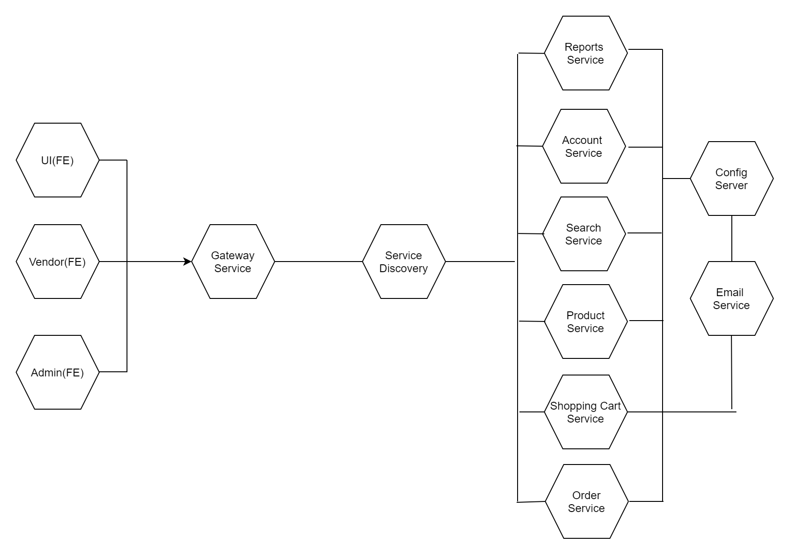
Architecture

Slide 7
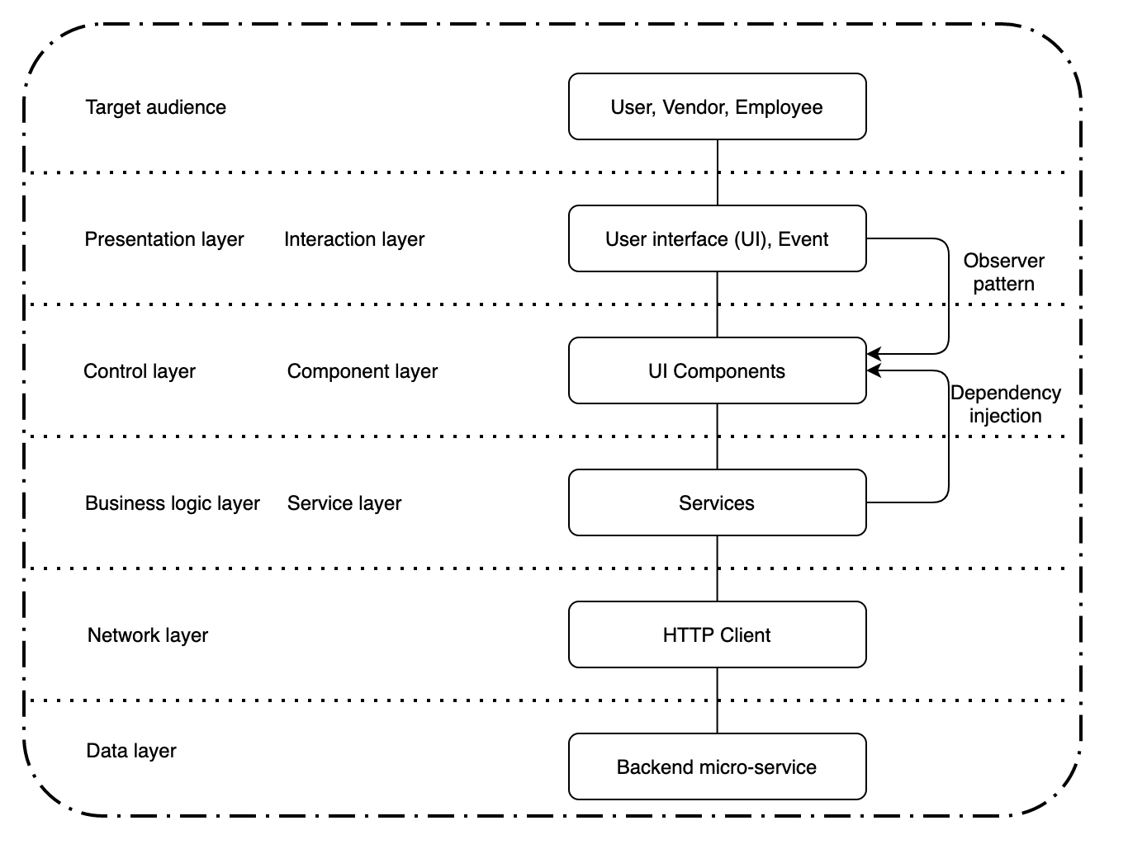
FE Architecture

Slide 8
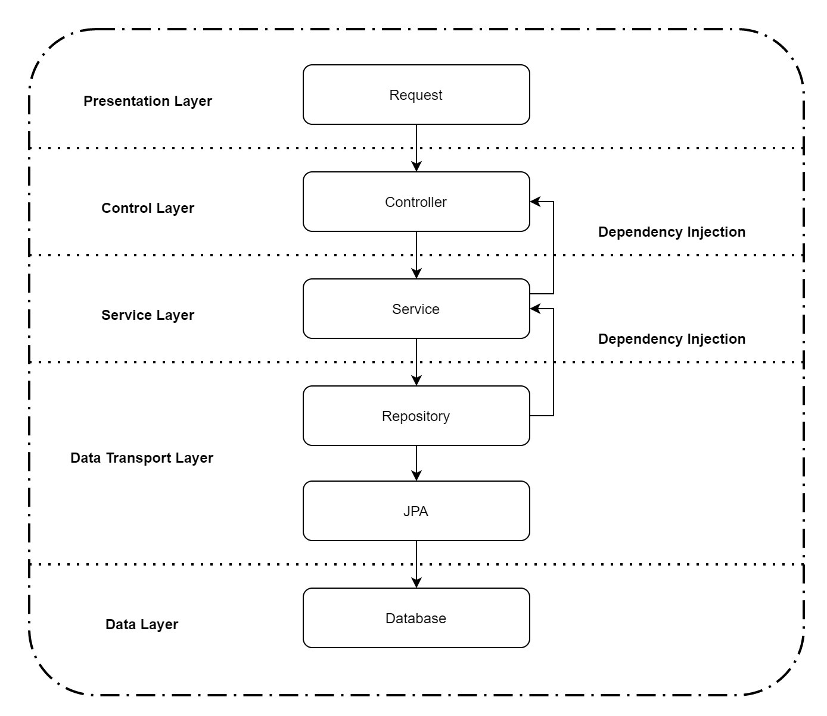
BE Architecture

Slide 9
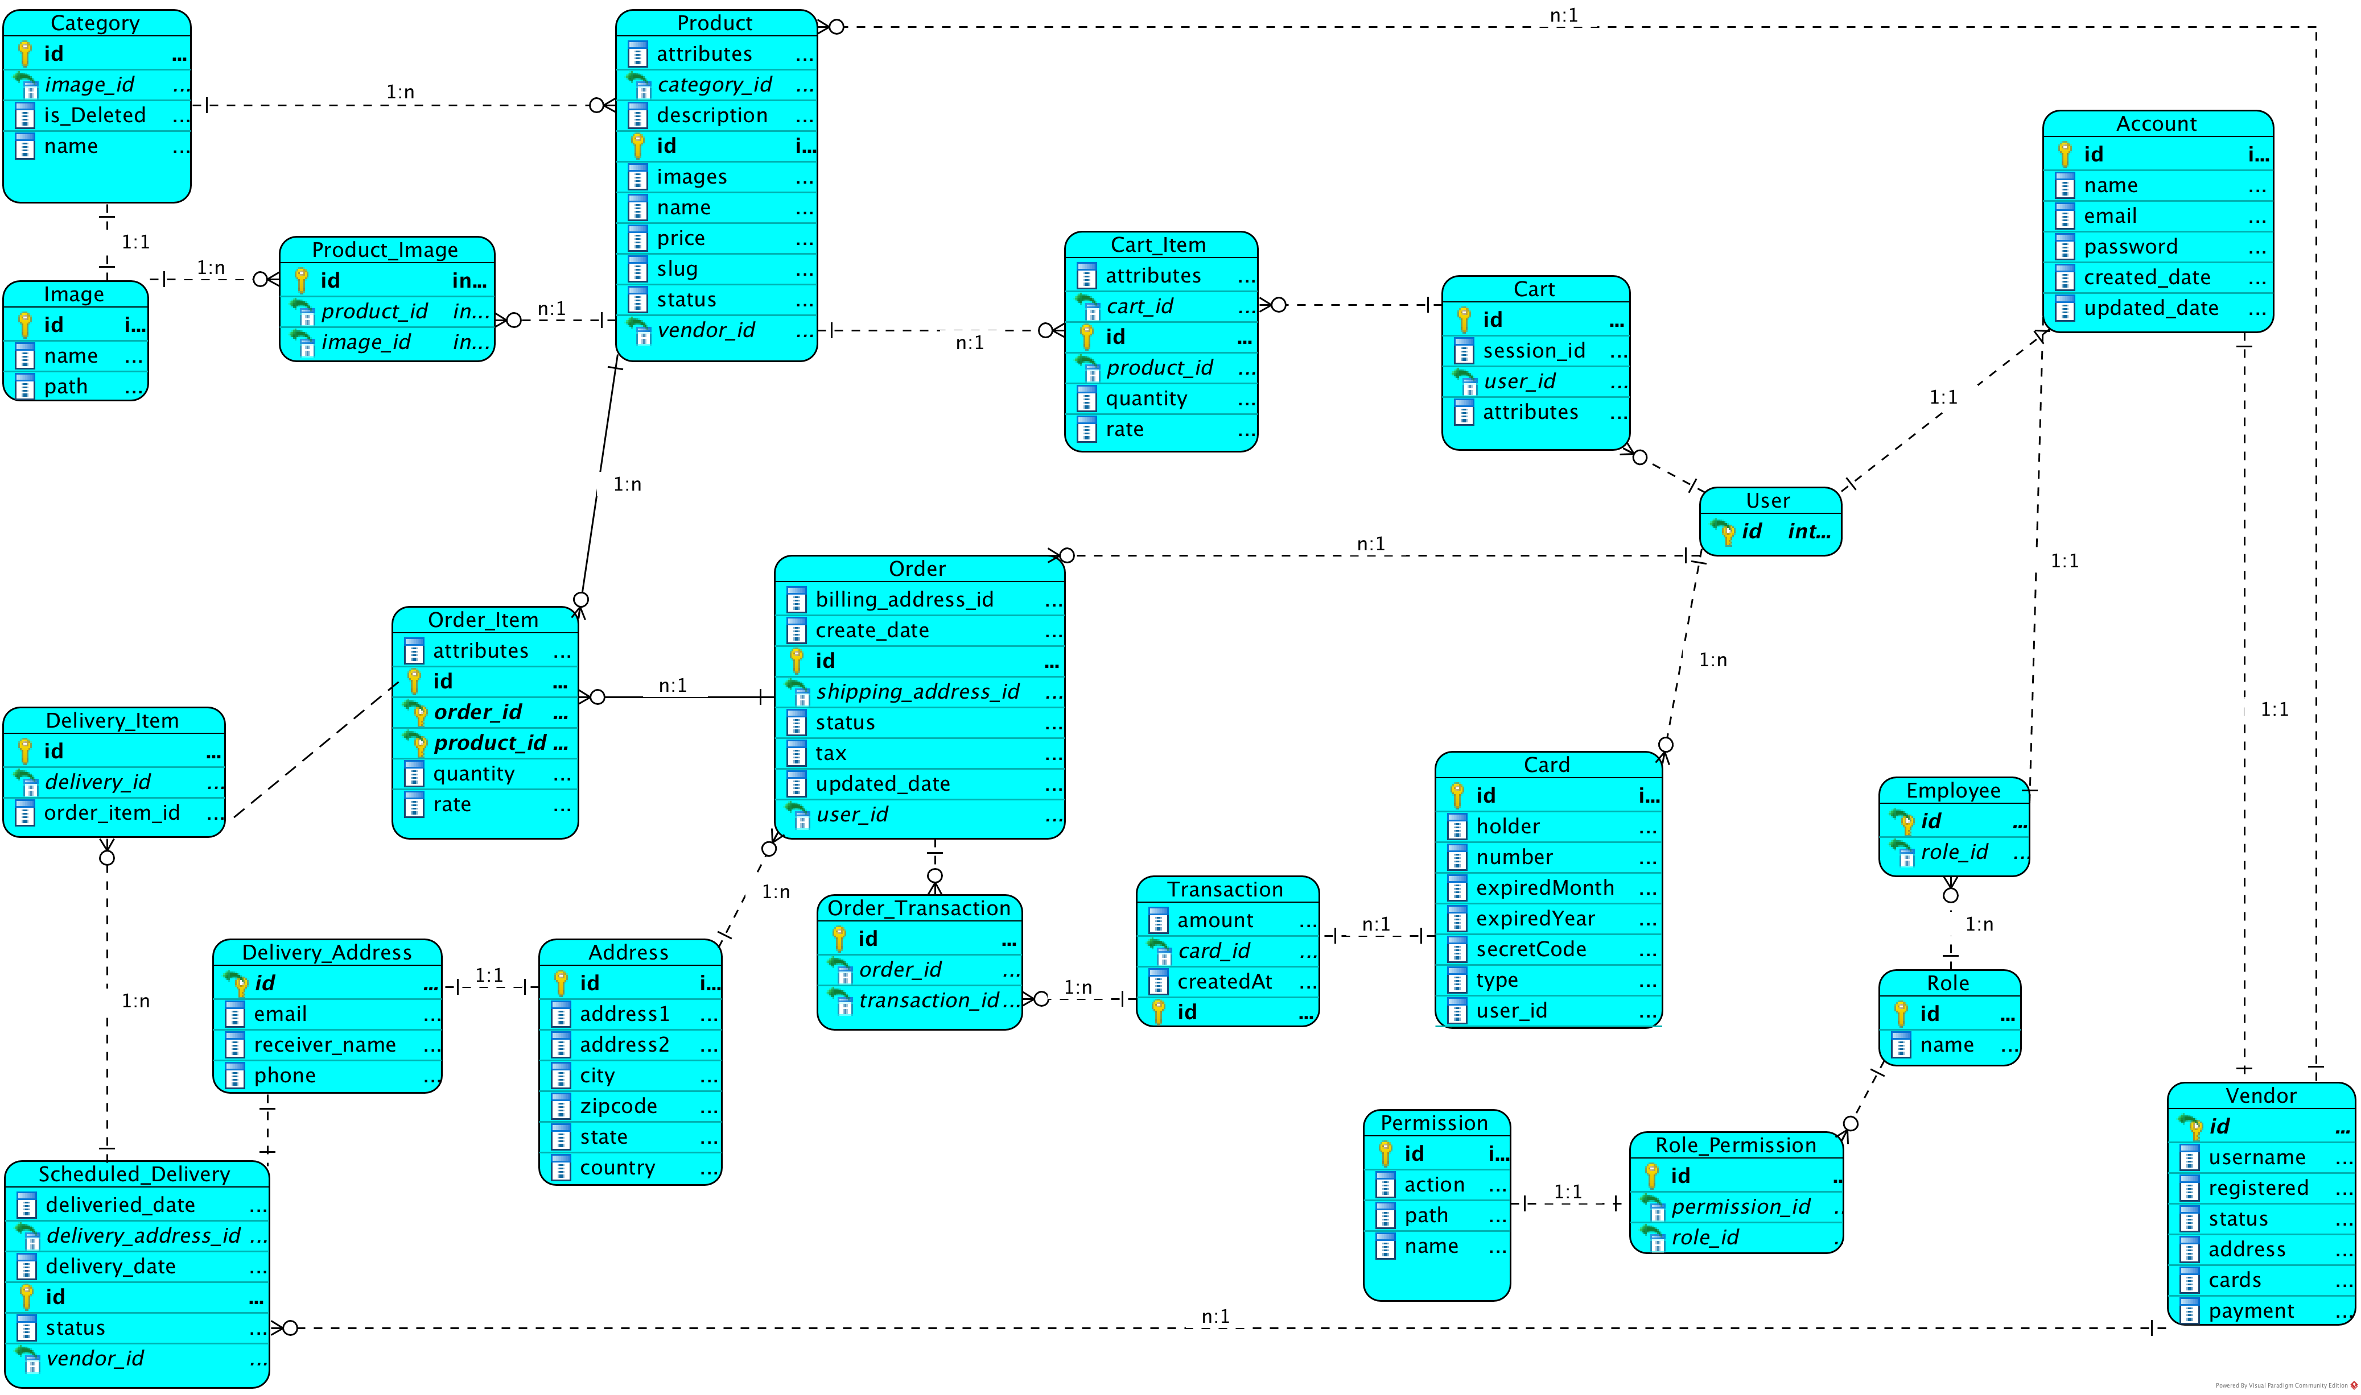
DB Design

Slide 10
Database Transaction Management
Hibernate
JPA (Entity Manager, Session Management )
Database (MySQL)

Slide 11
Work Breakdown Structure
Sandeep’s task: Setup Docker, Eureka, Zuul, Git repositories
Akjol’s task: Cart/charge module
Batjargal’s task: Vendor/Admin UI module
Duy’s task: Report service
Fikir’s task: Product and category management
Purevdemberel’s task: Order/sales service
Manduul’s task: Frontend website
Samiksha’s task: Account service
Sibtain’s task: Account/Authorization and SMTP service
Zayed’s task: Search service

Slide 12
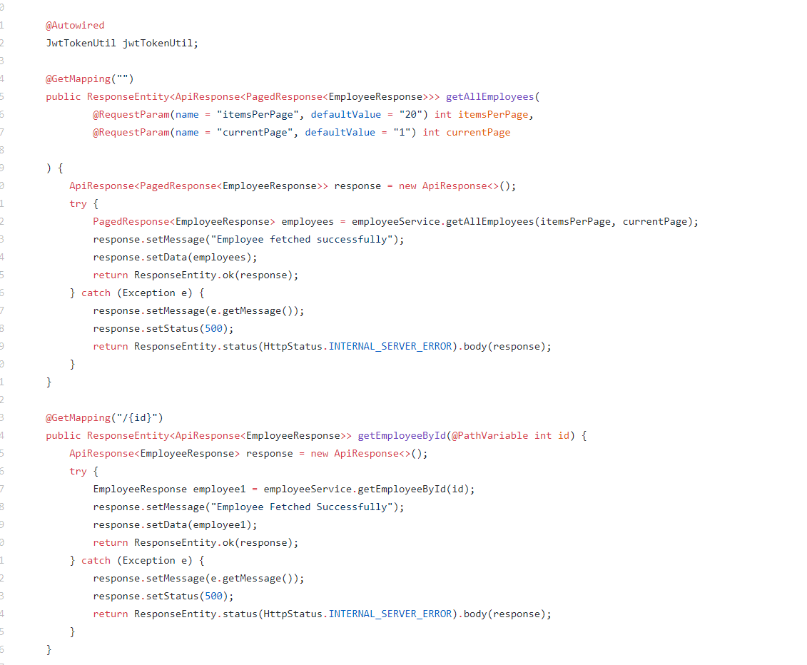
Code Quality Example

Slide 13

Security
Session management using JWT
Password based encryption
Application Authorization Framework (AAF)
Role and Permission based control
HTTPS support
HTTP security headers

Slide 14
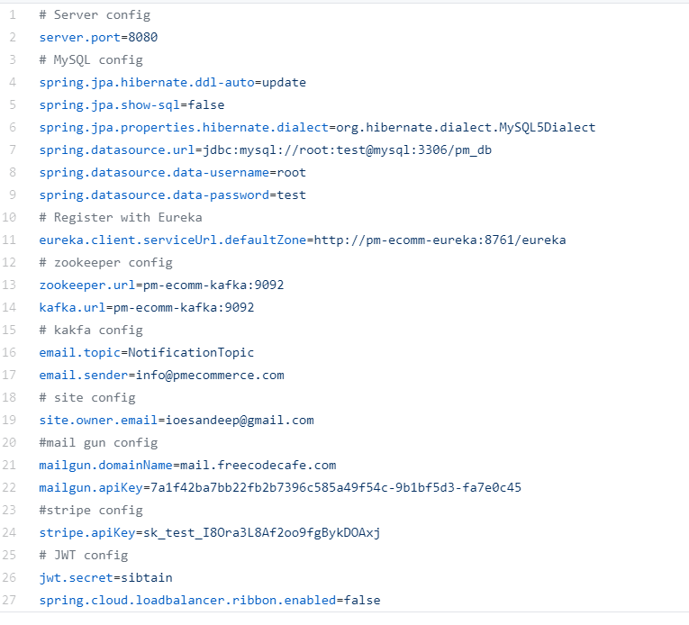
Central Configuration Service

Slide 15
Communication Management
Regular Team meeting after class
Task distribution
Task tracking via Trello
Problems were discussed with team members
Frequent consultation with the team lead to clarify any confusions and verification

Slide 16
Time Management
Planning before execution
Discussing before developing
Code review before merging
Proper task distribution
Immediate support from team lead

Slide 17

Cost Management
Used open-source tools
Strictly followed the original scope of our application
Assigned tasks properly to team members
Used microservices architecture which proved to be cost effective, maintenance and adding new features
Highly scalable project

Slide 18
Risk Management
Pair programming
Task tracking
Daily standup meeting to discuss progress and risks
End of the day meeting to discuss progress of the current day
Used only known technologies to reduce our risk of spending a lot of time on learning

Slide 19
SCI Points
The outer depends on the inner. The UI modules depend on backend services.
Life is always found in layers. We have a microservice for each feature.
Purification leads to progress. Testing the application properly creates a good quality software.

Slide 20
Fun Facts
A multi cultural team from 6 countries
20K+ lines of codes written.
500+ commits on GitHub
1600+ hours of software programming
17 microservices were developed
41 tables in the database were created
50+ team meetings
Production ready application

Slide 21

Let’s head to my browser for a live demo, shall we?

